Slide 1
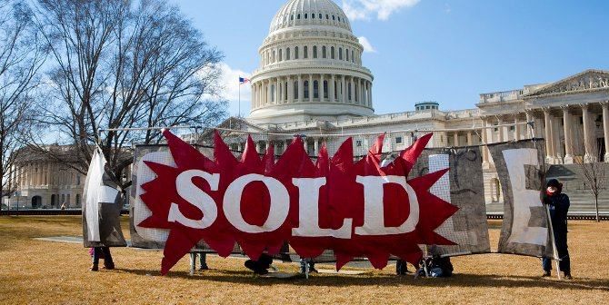

Follow the Money
Kate Field, J.A. Gorman, Angelique Tucker and Lauren Van Wagoner

Slide 2

Overview
Kansas
Senate:
Jerry Moran
Roger Marshall
House Representatives:
Tracey Mann
Jake LaTurner
Sharice Davids
Ron Estes
We will be allegedly breaking down congressional districts in Kansas and Missouri to see whether or not the top donors correlate with the candidate platform for Senate and House Representatives for the states of Missouri - Senate: 2 House: 8 and Kansas- Senate: 2 House: 4.
Missouri
Senate:
Josh Hawley
Roy Blunt
House Representatives:
Cori Bush
Ann Wagner
Blaine Luetkemeyer
Vicky Hartzler
Emmanuel Cleaver
Samuel Graves
William(Billy) Long
Jason Smith
Top Donors
“Fake News”
Italics: not a resident

Slide 3

Datasets
Congressional Websites Individually
Jupyter Notebook
Mongo
API Keys
https://api.open.fec.gov/developers/
Opensecrets.org
The Pits of Hell

Slide 4
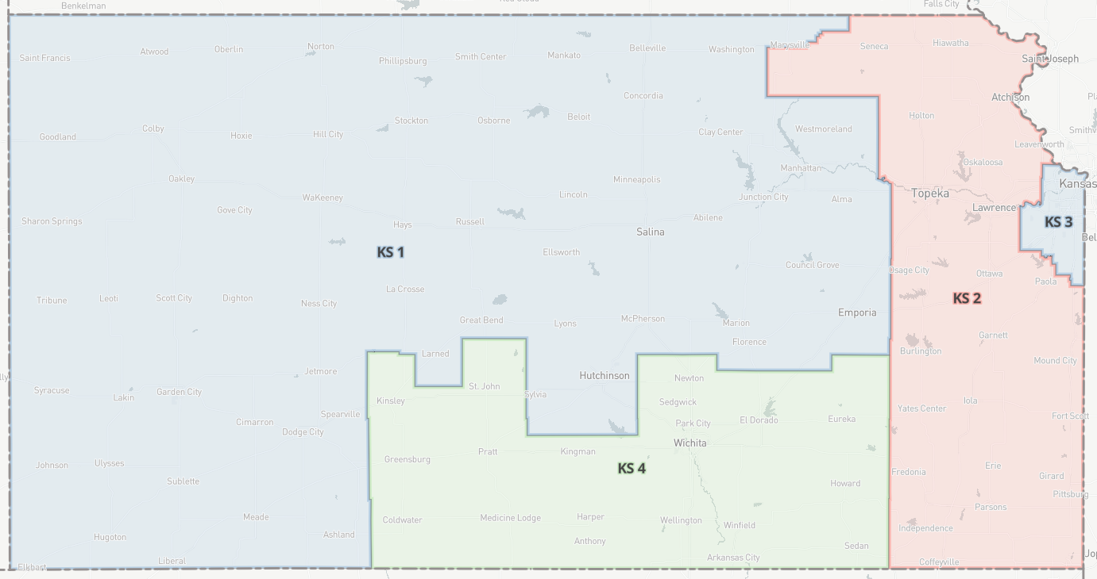
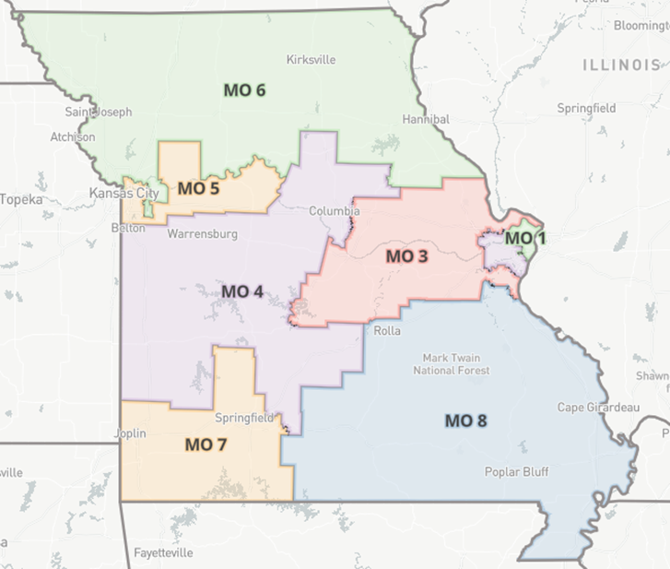
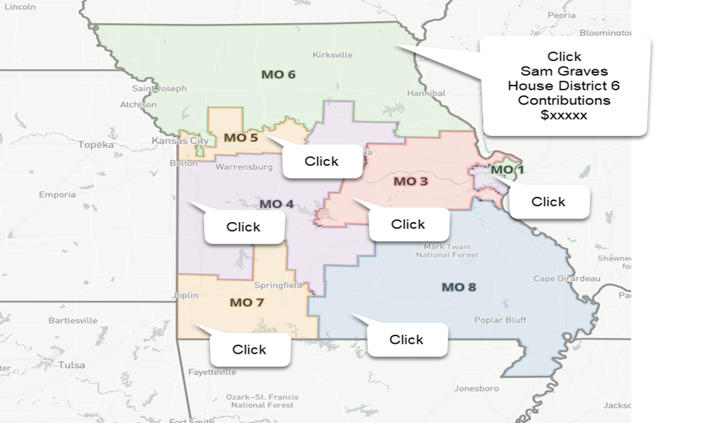
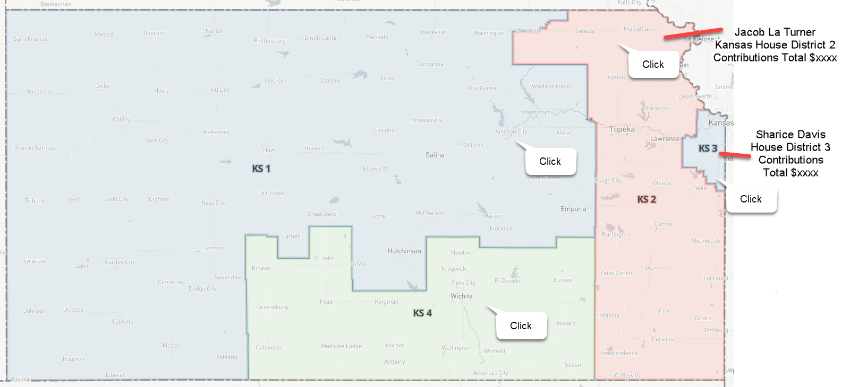
Design Ideas for Kansas and Missouri

Slide 5
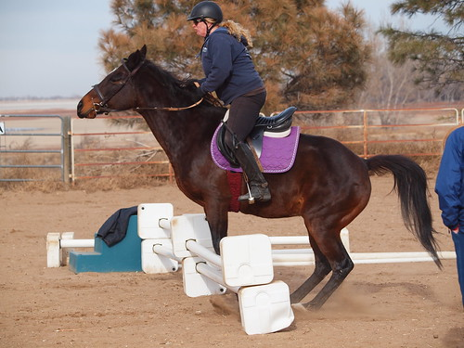
Difficulties
Opensource data was too big for what we needed. We had to get help to narrow down the data that we needed.
The FEC website was a huge struggle to create the API Key since there is so much data collected. It was very difficult to collect the specific data that we needed for the states
Bootstrap didn’t want to work at first.
SOOOO MUCCCCHHHH DATA!!!!!!!!!!!!!!!!!!!!!!!!!!!!!!!!!

Slide 6
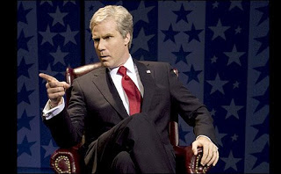
Git Hub Repository
https://jagorman.github.io/Follow-the-Money/index.html

Slide 7

Ending Thoughts
Once we get our data figured out, we all believe this will be a great final project.
This project will be a great voter education tool for future elections.
We are frustrated that our data wasn’t able to work for this project but are happy with what we all accomplished like anxiety attacks and physical pain.

